Slide 1
Realized Volatility Prediction
Shira Rozenthal & Alex Olteanu
Shira Rozenthal & Alex Olteanu
Faculty Mentor: Professor Hamm

Slide 2
Problem Statement (Overview)
We will explore the relationship between market interest, order execution, and short-term changes in volatility in the provided high-frequency data.
The ultimate goal is to predict where a stock’s volatility will realize in the 10 minutes following a market order, and do so as accurately as possible market-wide.
We will measure our effectiveness using Root Mean Square Percent Error (RMSPE) in coordination with the competition’s evaluation standards.
Notes:
Alex

Slide 3
High Frequency Trading Data
Order Book: Effectively representative of interest in the market, this file contains the ticker, ask/bid price, ask/bid size, and time of a received market order.
Trades: Derived from the file above, this file contains the ticker, price, size, and time of those orders that actually executed.
Training Data: Organized by the corresponding ticker and time IDs, this file contains the target realized volatility computed in the 10-minute window that follows the feature data.
Test Data: Formatted like the training data, a small portion is available for download.
Notes:
Shira

Slide 4
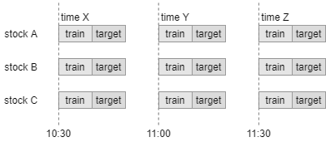
Notes:
Alex

Slide 5
Overview of Approach
Reverse engineer TimeID
Feature engineer based on chronological TimeID sequence
Run more basic models and see how well we can do with those
Continue to feature engineer
Attempt to work with some deep learning models used by top submissions
………
Minimize RMSPE
Notes:
Shira

Slide 6
Previous Work
Looking at the Leaderboard: This is a former kaggle competition, so our most useful resource will be the (few) leading solutions that published their successful approaches.
FINE7370 – Algo Trading & Quant Strat: We are auditing this graduate-level finance elective that delves into the mathematical and financial drivers of volatility in dynamic market data.
Notes:
Alex

Slide 7
So Far: Access Functions
defined functions for readily extracting layers of a parquet file
read_parquet_file(data_type, stock_id)
filter_data(df, time_id=None, seconds_in_bucket=None)
extract_data(data_type, stock_id, time_id=None, seconds_in_bucket=None)
built out functions to visualize market interest
plot_trading_volume(stock_id, time_id)
plot_bid_ask_volume(stock_id, time_id)
plot_bid_ask_price(stock_id, time_id)
visualize_spread_and_trades(stock_id, time_id)
Notes:
Alex

Slide 8
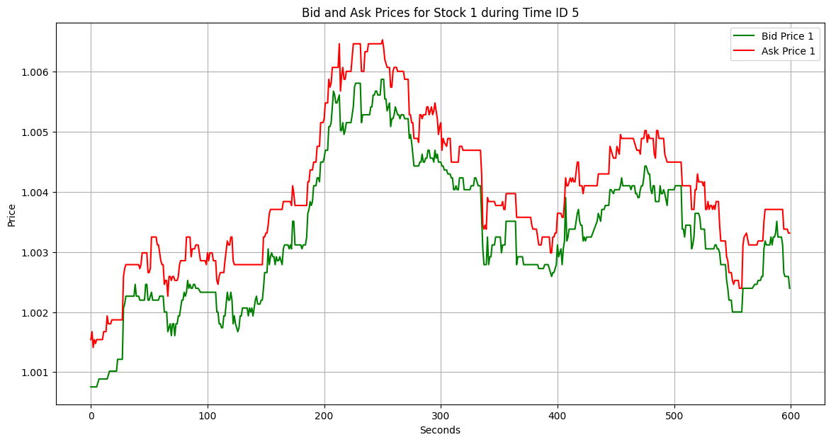
Notes:
Alex

Slide 9
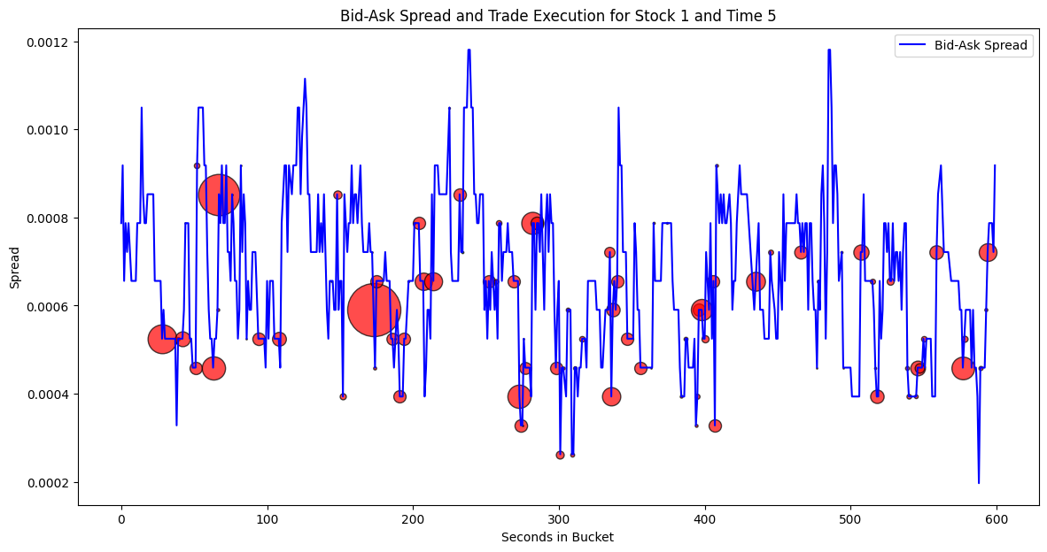
Notes:
Alex

Slide 10
So Far: Reverse Engineering Time-ID
Not only are the timeIDs ambiguous, they're also randomly labeled. In chronological order, the first 5 timeIDs are: 4294, 24033, 5666, 29740, 22178.
Although chronologically-sequenced data won’t be of help to our model because volatility is a non-stationary series, we need it in order to:
Get an accurate representation of our test error
Build features around the relationship between “neighboring” timeIDs
Notes:
Shira

Slide 11
So Far: Feature Engineering
Flattened 600 observations per TimeID.
Generated 75 features for model prediction.
10 features with positive correlations (>0.5).
In the process of generating chronological (TimeID neighbor) features.
Notes:
Alex

Slide 12
So Far: Running K-NN Model
Have a running K-NN model with a 0.273 RMSPE
Down from 0.34 (Naive predictor)
0.31 (Previous build).
Performed multiple variations of K-NN model with different combinations of features.
Plan to explore other models.
Notes:
Alex

Slide 13
Timeline
Milestone 3
Milestone 4
~Mardi Gras
April 2024
Reverse Engineer Time-ID
Begin Feature Engineering
75 Features engineered
Various KNN designs
Explore sequential models and neural networks
RMSPE < 0.27
RMSPE < 0.2 (?)
Submit our solution to Kaggle (!)
Notes:
Shira

Slide 14
For Next Semester:
Explore sequential models as opposed to flattening training data.
Continue with TimeID feature engineering and run a K-NN model to identify
most valuable TimeID “neighbors”.
Attempt to implement some higher-level deep learning models as used
by top scoring submissions.
…
Minimize RMSPE and submit to Kaggle !
Notes:
Shira

